Slide 1
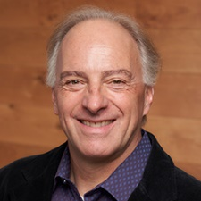
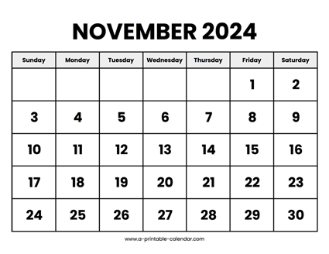

CS 310 : Scalable Software Architectures
Class session on Tuesday, November 12th
Notes:
Focus this week:
Software execution and packaging
Docker
Async architectures, Distributed systems
CAP theorem
Midterms have been graded; details in email
Project 03 due Friday (Sunday late)
Serverless, event-driven PDF analysis
Gradescope will open today
No class session Thursday --- office hours instead
No class Tuesday 11/26 --- thanksgiving week

Slide 2
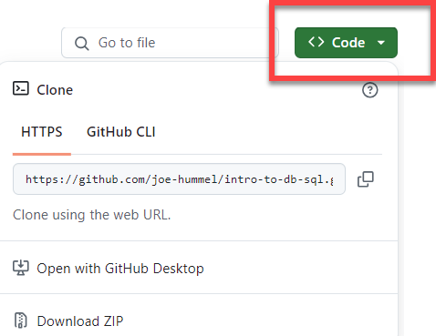
Getting the necessary software
Make sure Docker Desktop is running
Download files you need for today
https://github.com/joe-hummel/docker-lambda-movies
Install desktop version of Postman app
visit https://www.postman.com/
download desktop app (click link in lower-left corner)

Slide 3
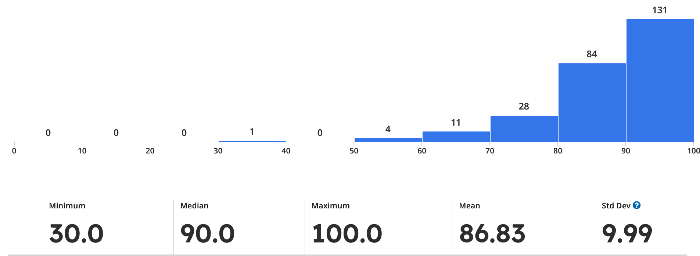
Midterm

Slide 4
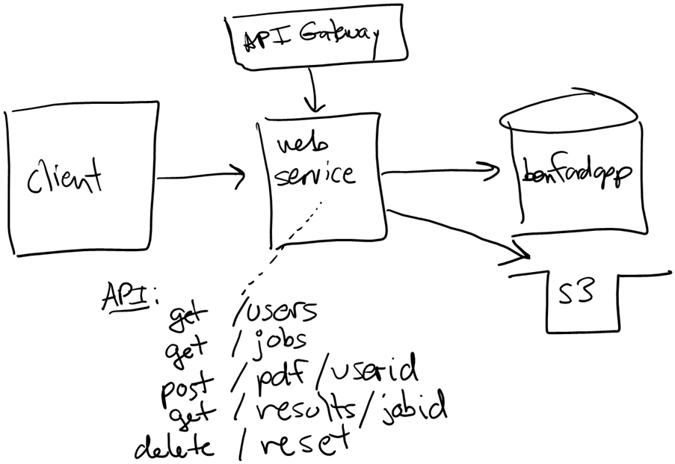
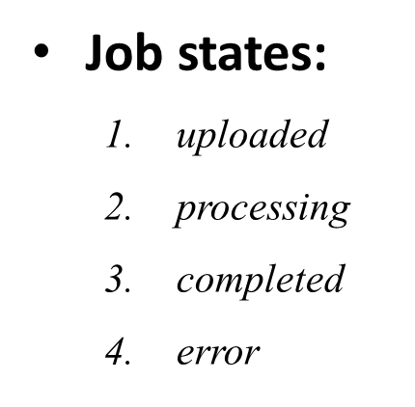
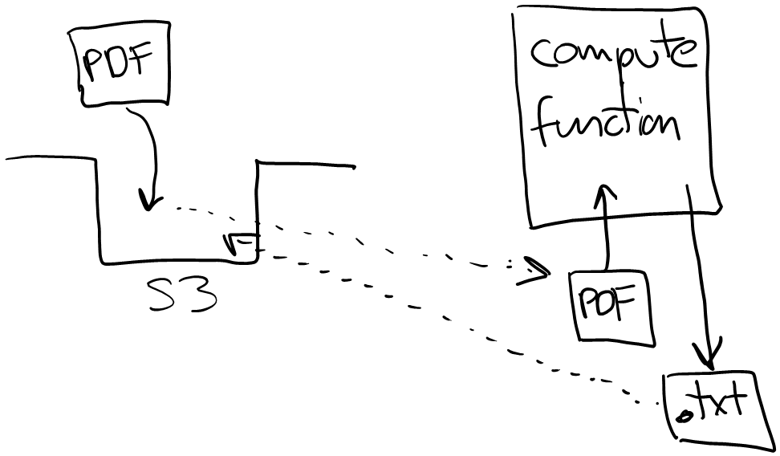
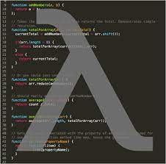
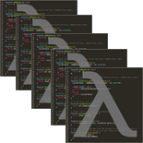
Project 03
Project 03 uses a different architectural approach:
Event-driven
Serverless
Asynchronous API

Slide 5
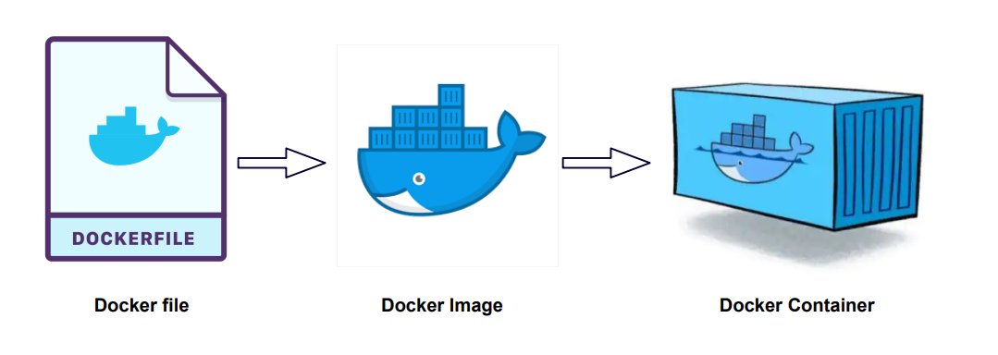
Overview
A Dockerfile is a text document that contains the commands needed to build a docker image
Think of a docker image as a snapshot of the software – a large file that can be stored and shared
Docker Hub is the app store for docker images
A docker container runs a docker image

Slide 6
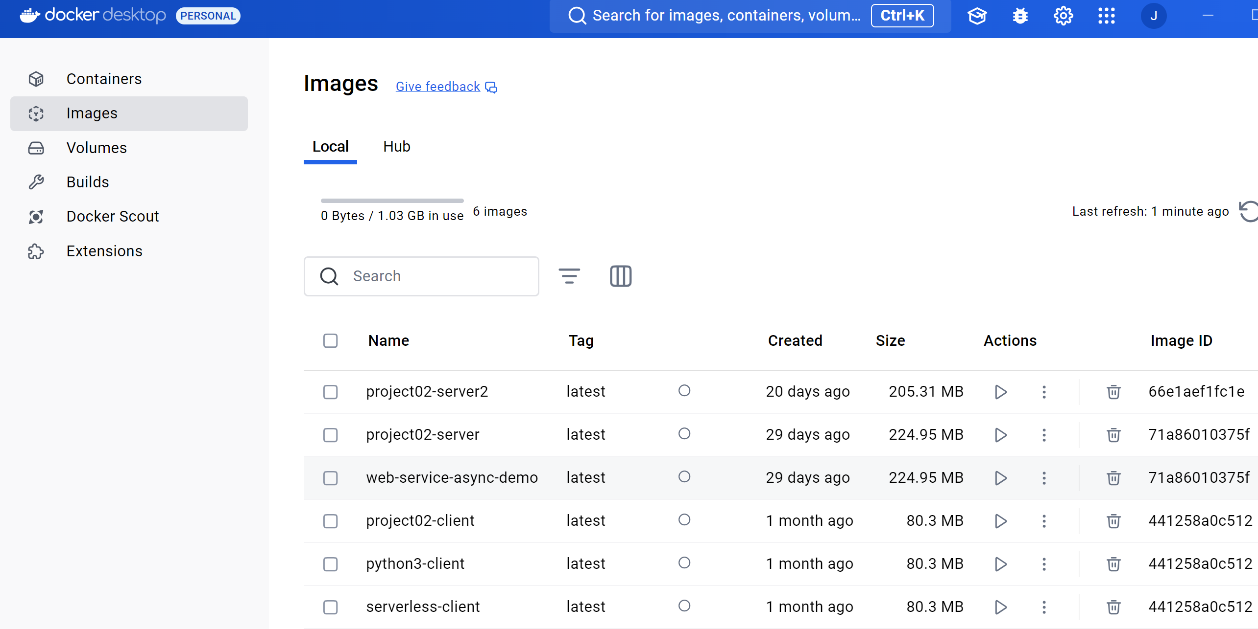
Images vs. Containers
Docker desktop will show your images and containers…

Slide 7
Docker Commands
Command | Usage | Example
docker run | Start a new container | docker run image_name
docker build | Build a Docker image from a Dockerfile | docker build –t image_name .
docker pull | Pull an image or repository from Docker registry | docker pull ubuntu
docker push | Push a local Docker image to a registry | docker push my_username/image_name
docker images | List all the Docker images stored locally | docker images
docker ps | Shows all running containers. Flag -a shows all containers (running & stopped). | docker ps -a
docker stop | Stops one or more running containers | docker stop container_name
docker rm | Remove a specific stopped container | docker rm container_id
docker rmi | Remove one or more Docker images | docker rmi image_name

Slide 8
Example #1
Let’s run MySQL on your local machine using Docker…

Slide 9
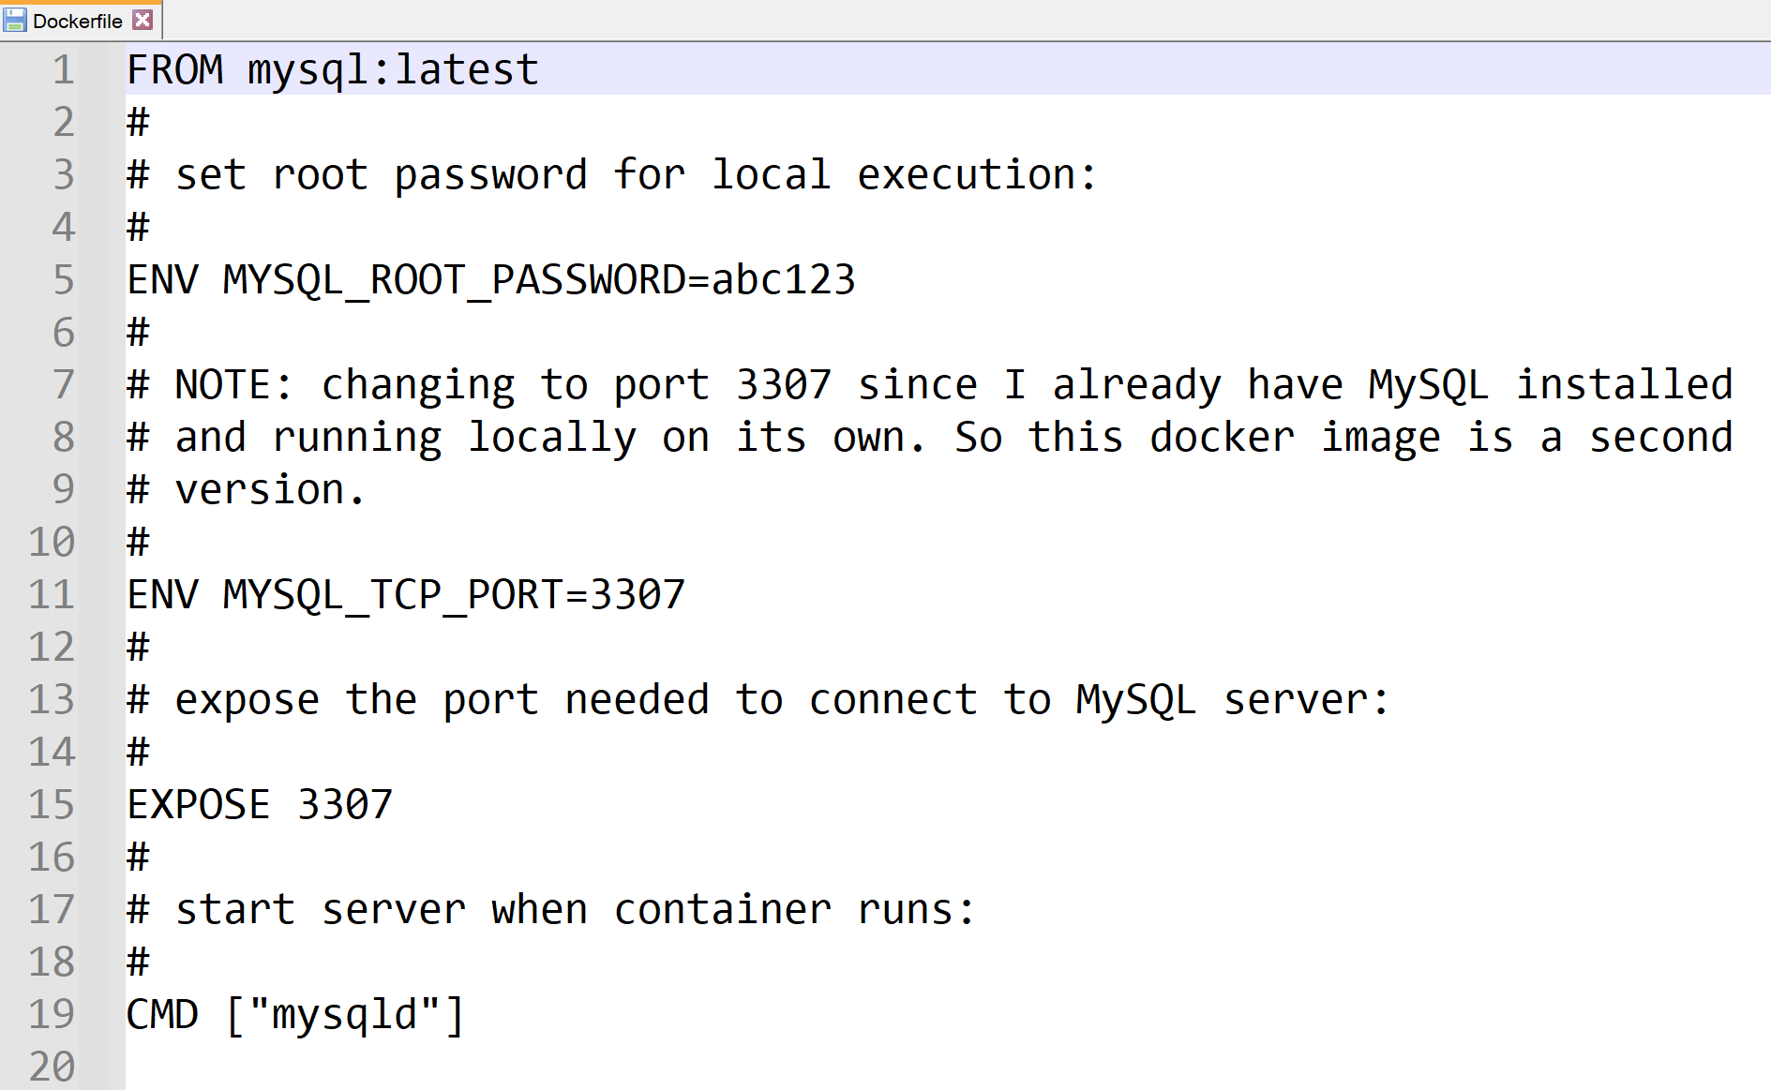
Step #1
Create the Dockerfile

Slide 10
Step #2
Build the docker image “mysql”
-t tag the image so easier to refer to
. refer to Dockerfile in current directory
docker build -t mysql .
docker images

Slide 11
Step #3
Run the docker image => docker container
-d detach from terminal window to run in background
-p map local port to container port
--name container so easier to refer to when running
--rm to remove container when it stops
docker run -d –p 3307:3307 --name mysql --rm mysql
docker ps

Slide 12
Step #4
Did it work? Let’s interact using cmd-line tool…
docker exec -it mysql bash
mysql –u root –p
abc123
show databases;
exit
exit
docker stop mysql
docker ps

Slide 13
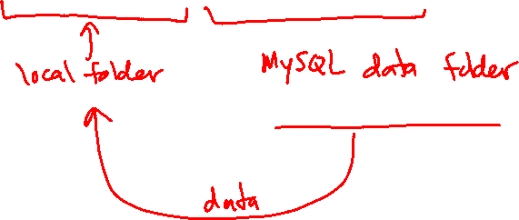
Persisting data in the database?
By default, docker images are stateless --- you do not save data within the docker image
Instead, you mount a local folder ("volume") and save the data to your local machine with -v option
docker run –d -v /data/mysql:/var/lib/mysql ...
Notes:
NOTE: on a windows machine, where is /data/mysql? In WSL you can type "explorer.exe ." to see where this data will live.

Slide 14
Example #2
Let’s implement a Lambda function in a Docker container to retrieve movies from MovieLens DB running in AWS…

Slide 15
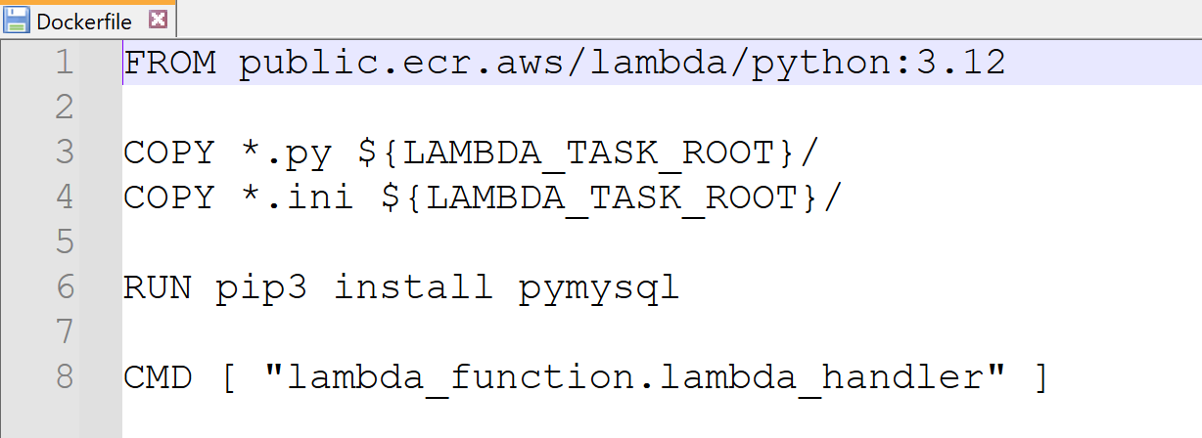
Step #1
Create the Dockerfile

Slide 16
Step #2
Build the docker image “lambda-movies”
docker build -t lambda-movies .
docker images

Slide 17
Step #3
Run the docker image => docker container
-d option is NOT specified so we can see output from lambda
docker run –p 8080:8080 --rm lambda-movies

Slide 18
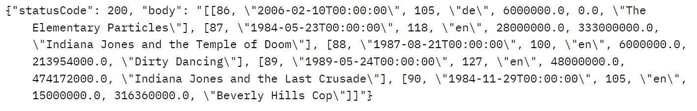
Step #4
Test locally using POSTMAN desktop app
POST
http://localhost:8080/2015-03-31/functions/function/invocations
BODY raw JSON
{
"pathParameters":
{
"limit": 5,
"offset": 50
}
}

Slide 19
Step #5
Deploy to AWS ECR, create lambda function from ECR image, test within Lambda console…

Slide 20
Push to ECR, load into Lambda, test
Switch over to AWS:
Search for ECR, open ECR console
Create a repository with same name as container image
Select repository, view "Push command"
Open terminal window on your laptop (AWS CLI must be configured --- we did this in project 01)
Execute each of the "push" commands to push image --- skip the command that builds the image, we did that
Switch to Lambda console
Create new lambda function
Select "Create from Image", and select image from ECR drop-down
Name function and create
Configuration tab: increase timeout
Deploy
Test --- logs are available from CloudWatch

Slide 21
That's it, thank you!

